Slide 1

Travel Guide
Submitted To – Mr Tushar
Submitted By – Japish Bagga
2210990432

Slide 2

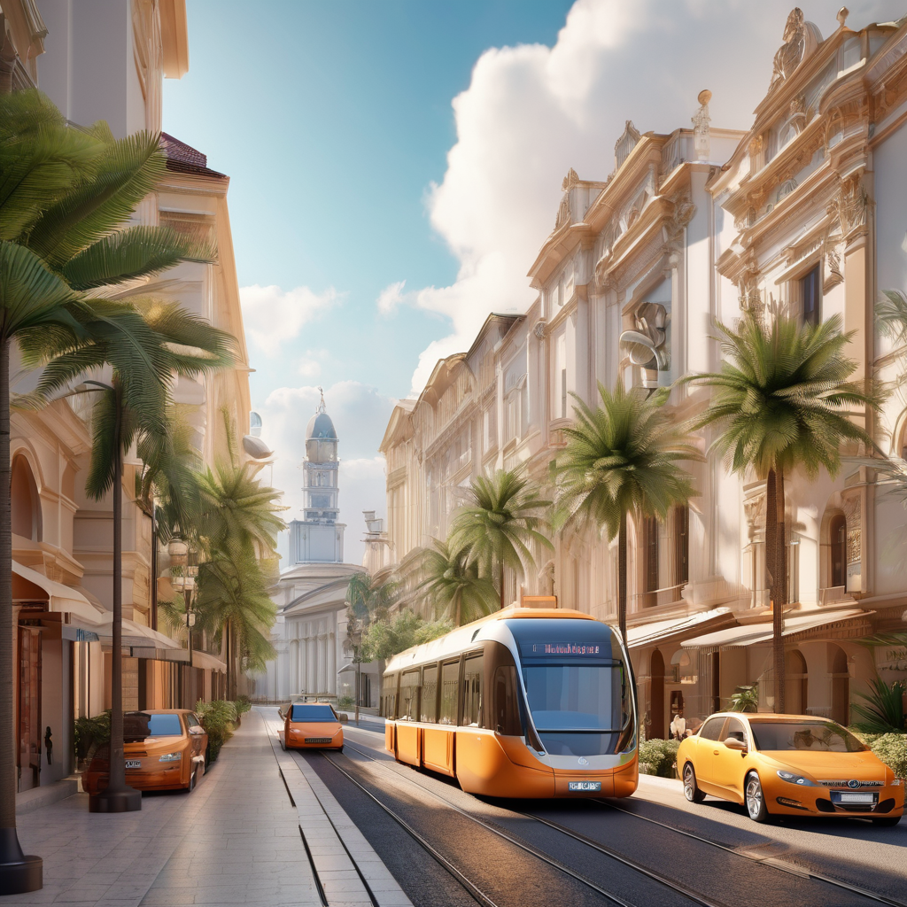
Introduction
Purpose of the Project
The purpose of the travel guide project is to create a Python-based application that provides users with comprehensive information and recommendations for various travel destinations.
Goals of the Project
Develop a user-friendly interface for easy navigation and interaction.
Gather and organize data on popular tourist attractions, accommodations, restaurants, and transportation options.
Implement search and filtering functionalities to help users find specific information.

Slide 3
Setting up the Python Environment
Requirements
Python 3.7 or higher
pip package manager
Virtual environment
Steps
Install Python: Download and install the latest version of Python from the official website.
Install pip: pip is a package manager for Python. After installing Python, pip should already be available. You can verify this by running pip --version in the command line.
Create a virtual environment: A virtual environment allows you to isolate the Python environment for your project. Run python3 -m venv myenv to create a new virtual environment named myenv.
Activate the virtual environment: On Windows, run myenvScriptsactivate. On macOS and Linux, run source myenv/bin/activate.
Install project dependencies: Use pip to install the required packages for the travel guide project. Run pip install -r requirements.txt to install the packages listed in the requirements.txt file.
Set up the project: Clone the project repository from GitHub and navigate to the project directory.
Run the project: Execute the main Python file to start the travel guide application.

Slide 4

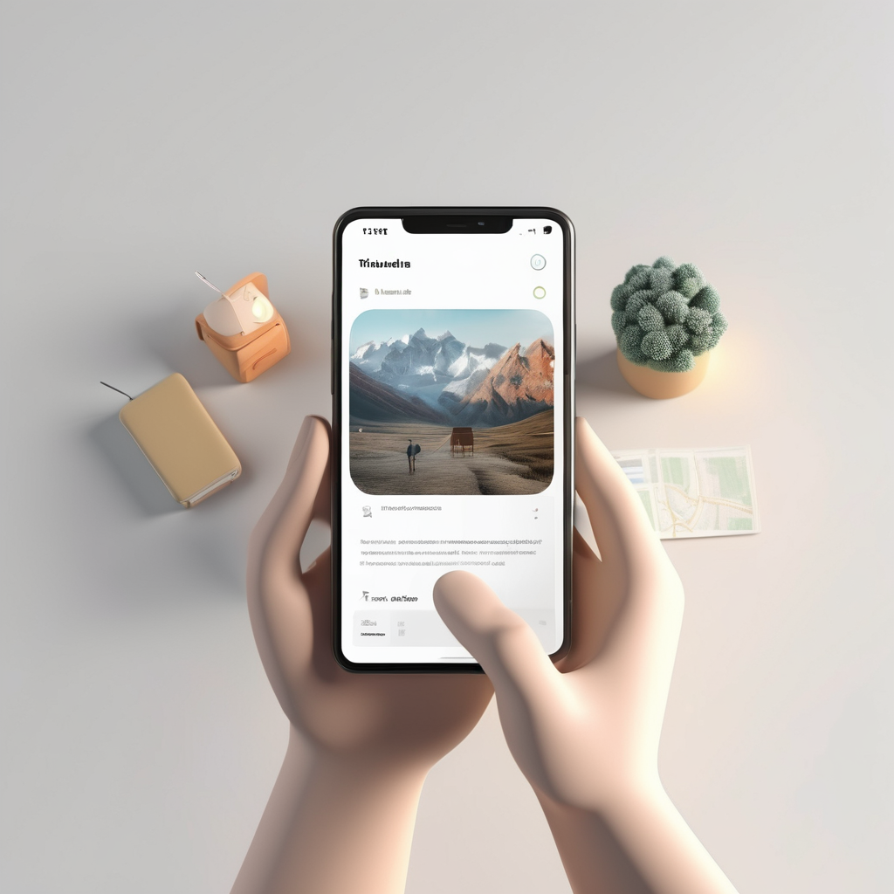
Adding Recommendations and Reviews
Finding Recommendations
Users can find recommendations for places to visit by browsing through the travel guide's curated lists, popular destinations, or searching for specific locations.
Leaving Reviews
To leave a review for a place they have visited, users can navigate to the place's page in the travel guide and submit their review along with a rating.

Slide 5
Enhancing the User Experience
Interactive Map
We have added an interactive map feature to the travel guide, allowing users to visually explore different destinations and attractions. Users can click on markers on the map to get more information about specific locations.
Personalized Recommendations
To enhance the user experience, we have implemented a personalized recommendation system. Based on user preferences and previous interactions, the travel guide now suggests tailored recommendations for accommodations, restaurants, and activities.
User Reviews
We have added a user review feature where users can leave feedback and ratings for destinations and attractions. This allows other users to make informed decisions based on real experiences shared by fellow travelers.
Seamless Booking
To streamline the travel planning process, we have integrated a seamless booking system. Users can now directly book accommodations, flights, and activities through the travel guide, eliminating the need to switch between multiple platforms.

Slide 6
User Feedback
Based on user feedback, the travel guide application should focus on improving the user experience by providing more personalized recommendations and better navigation. Additionally, users have expressed a desire for more detailed information about local culture and history, as well as more interactive features such as virtual tours and live events.

Slide 7
Technical Aspects of Travel Guide Project
Python Environment Setup
The project was developed using Python 3.8. The Python environment was set up using Anaconda, which includes a package manager for installing and managing Python packages.
Data Collection
Data for the travel guide was collected from various sources, including online travel forums, travel blogs, and government websites. The data was cleaned and preprocessed using Python libraries such as Pandas and NumPy.

Slide 8
THANK YOU

